Slide 1
Startup Program

Slide 2
Realize Your Product Promise
Notes:
ANSYS enables you to predict with confidence that your products will thrive in the real world. Customers trust our solutions to help ensure the integrity of products and drive business success through innovation. Industry leaders use ANSYS to simulate complete virtual prototypes of complex products and systems – comprised of mechanical, electronics and embedded software components – which incorporate all the physical phenomena that exist in real-world environments.
In today’s world, the value of being right – of creating the next must-have product – is greater than ever. But the cost of being wrong – a highly publicized product failure for example – can be disastrous.
We believe that every product is a promise; a promise that is will perform properly, not fail unexpectedly. That’s where simulation makes a difference. Our solutions enable you to simulate complete virtual prototypes to ensure that your products will thrive in the real world. Computers transformed the office and publishing world, and similarly simulation technology enables the “engineering desktop” where new ideas and innovation can be tested at the speed of human thought.

Slide 3
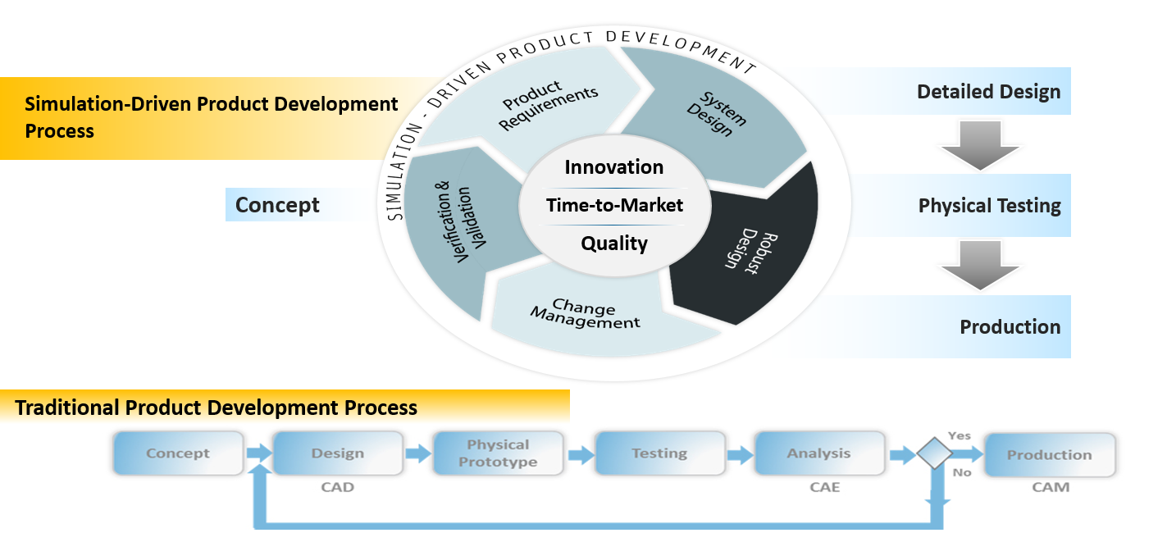
Impact of Simulation Driven Product Development
Notes:
By leveraging Complete Virtual Prototypes early in the conceptual design process, engineers can disruptively innovate by rapidly altering design choices and evaluating performance insights.
In the past simulation was primarily used as a forensic tool, used late in the cycle, for understanding why something didn’t work. Because most design efficiencies are locked in early in the process, companies were often constrained in the fixes they could make. For example, they might have to try to redesign one component, but without changing all the adjacent components in the system, thus triggering retooling and inventory concerns.
What’s different with our vision? Our approach provides customers design understanding though a Complete Virtual Prototype. The key point is that we can look at complex interactions…evaluate a range operating assumptions,… all to find out what vulnerabilities are lurking just over the horizon. We can quickly look at alternatives that simply would not normally be considered due to time limitations.
With simulation, at the speed of thought, you can look at total life-cycle costs over time. You can go through thousands of iterations in the time that you might devote to one physical prototype. In the virtual world, it is actually a bonus to fail-early, fail-often and to iron out issues before committing to the physical world.

Slide 4
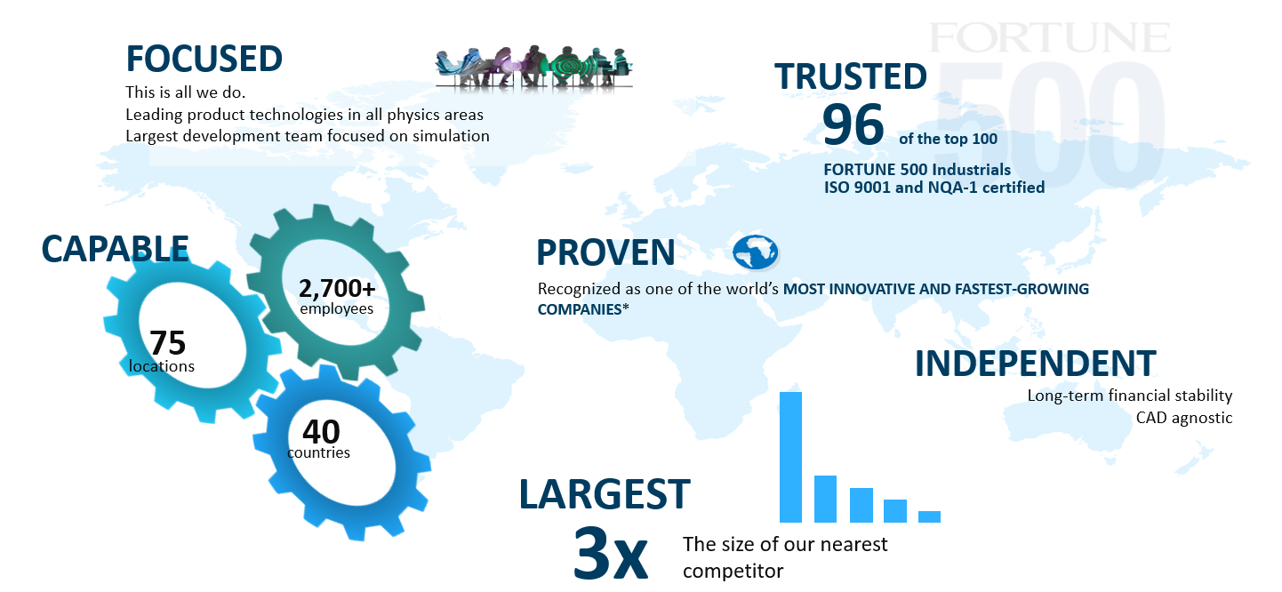
ANSYS is the Leader in Simulation
*BusinessWeek, Fortune
Notes:
Indisputably from a numerical standpoint (we are 3x the size of our nearest competitor), but we also endeavor to sustain this leadership in terms of technical capability and innovation. It is a big job, and our focus on this area has led us into a strong position. We have over 40,000 customers, including 96 of the top 100 industrial companies on the Fortune 500 List. We serve this global base with over 75 locations in over 40 countries.

Slide 5
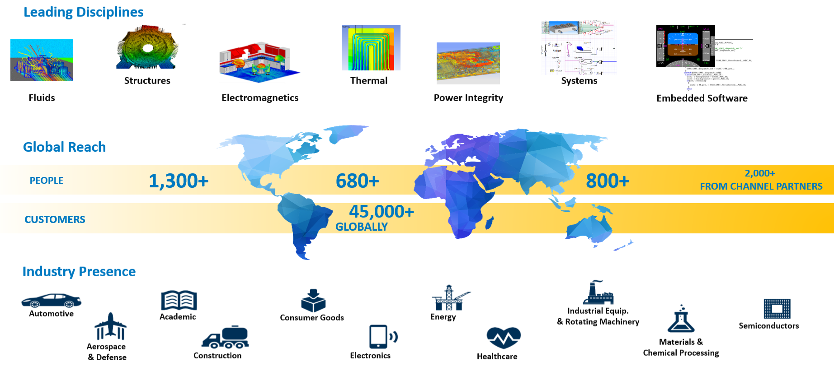
Industry Reach and Solution Offerings
Notes:
Our involvement in every major industry segment has provided us with the application know-how to help you solve your toughest problems. It has also resulted in advancements in our product capabilities and performance that are essential for applications within these and other industry segments.
Finally, where ever you or your engineers are across the globe, ANSYS can support you with nearly 3000 direct employees and over 2000 certified channel partners.

Slide 6
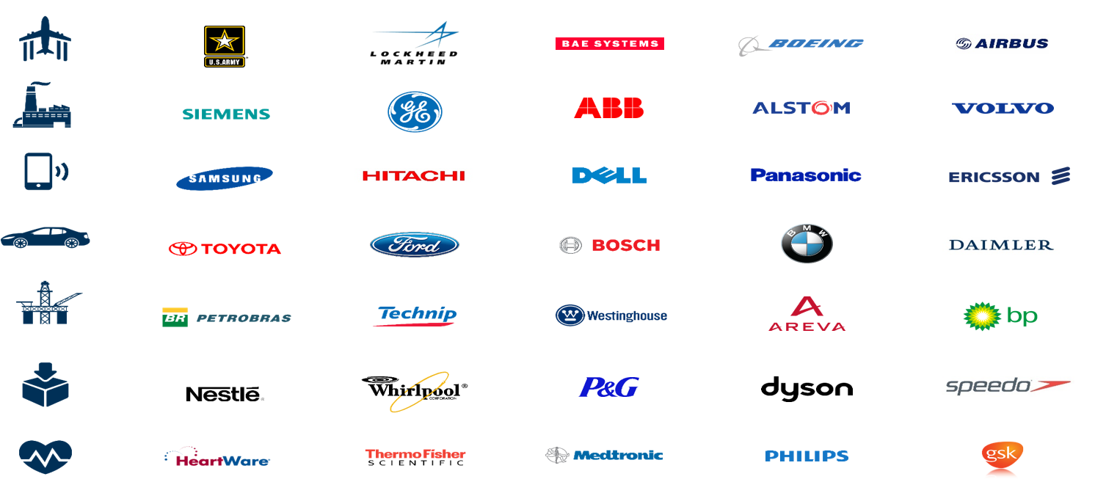
World-Class Companies Leveraging ANSYS
Notes:
Leaders in every industry depend on the broad set of ANSYS technology, industry expertise and global simulation support to realize their product promise. A day doesn’t go by when you are not interacting with an ANSYS-assisted product… whether it’s your smart phone, the mode of transportation you used today, to even food or health care products.

Slide 7
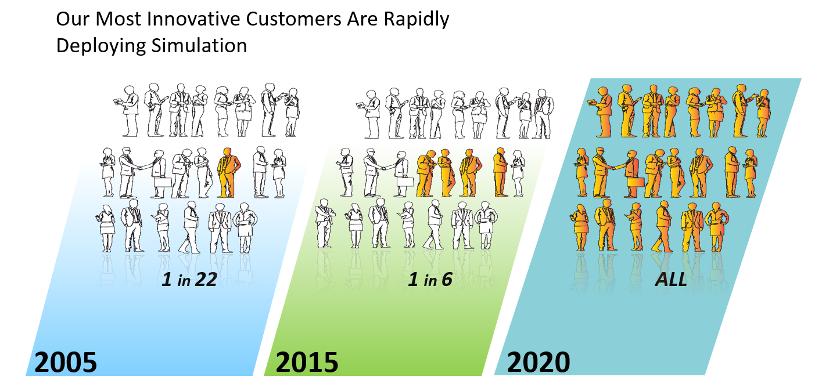
Every Engineer Will Use Simulation
Notes:
Years ago, when people thought simulation was saturated because it was too complicated, too hard to use, too computer intensive, we started on a bold mission. We felt EVERY engineer ultimately should be using simulation…to solve the very equations, on a massive scale, that they went to college to learn. At the time, this was not universally accepted, but we had heard the same thing about computers years earlier. In the 80’s, if you said that every engineer would have a PC with word processing on their desk, you would have been considered insane, and look how that has turned out. But here is some actual customer data showing over the years how simulation has become more ubiquitous, both by user and throughout the cycle….And while they are not there yet, notice how they play to get to everyone over the next few years.
We totally understand that this is a massive undertaking and that the technology, ours included, will need to continue to progress. The product has to be state of the art, but it must be easy to use. Neither one can be forgotten. Design engineers may not be as familiar with the technology, but they are not solving less difficult problems…they are still making the fundamental decisions that will dictate product cost, quality and success. Just creating a dumbed-down or simpler product will not do the job.

Slide 8
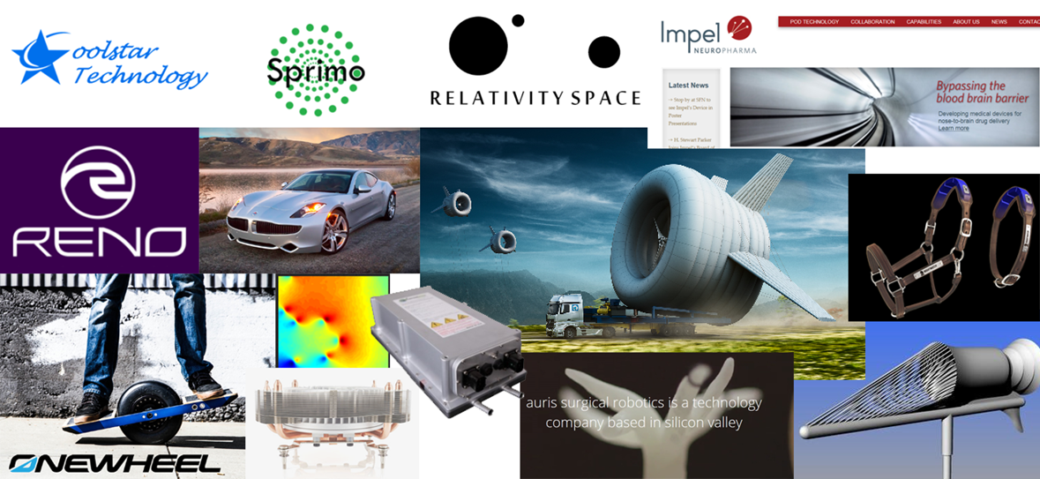
Startup Program
Notes:
We have over 540 startups on our program and the number continues to grow each week. All industries are represented, and we are already seeing success stories where simulation made a world of impact for the business.

Slide 9
Startup Program Benefits
Industry Leader: Simulation driven product development in all major physics Mechanical/Fluids and Electromagnetics as well as complex full System simulations.
Ecosystem: Largest simulation company in the world with 100’s of thousands of users globally. Plus, 450+ PHD level engineers working on support and development and 700 Support Engineers.
Reduce Costs: Leverage simulation to reduce manufacturing, materials, warranty, and prototype costs.
Reduce Time to Market: Simulation will impact your design, testing, and prototype timeline.
Validation: ANSYS simulation will allow you to validate your technology, prove real-world functionality, and gain further funding.

Slide 10
Startup Eligibility Criteria
Privately held company.
No engineering services/consultant companies.
Less than (10) ten years old.
Less than $5M USD Revenue per year (at time of application).
Marketing PR/collateral commitments.
Willing to make exclusive use of ANSYS products for simulation work.
Cannot be a pre-existing ANSYS commercial customer (includes current and lapsed TECS customers).
Cannot be a new division of a pre-existing company.
Must meet standard ANSYS Export Compliance requirements.
Primary user(s) of ANSYS software license(s) has Bachelors (BSc) or higher degree in Science or Engineering or be willing to invest in training to learn to use the tools.

Slide 11
Product Bundles
Bundles are available with two licenses for term of up to one year with two renewal opportunities based on meeting success criteria. Each startup can purchase up to 5 bundles.
ANSYS Startup Program - Structural and Fluids Bundle
Mechanical Enterprise
CFD
AIM
SpaceClaim Direct Modeler
HPC Pack
Geometry Interfaces
...And More!
ANSYS Startup Program - Embedded Software Bundle
SCADE Suite
SCADE Display
SCADE Test
SCADE LifeCycle
ANSYS Startup Program - Electromagnetics Bundle
HFSS
Savant
EMIT
Maxwell
Simplorer
SIwave
Q3D Extractor
HPC Pack
Geometry/EDA Interfaces
...And More!

Slide 12
Marketing Partnership Requirements
Placement of the ANSYS Startup Program logo, linked to www.ansys.com/startups on your website in Partners or other relevant section.
Press release by startup within one month of joining the program (ANSYS will provide quote and review press release in advance).
Provide a testimonial using ANSYS template with relevant accompanying simulation images.
Promote ANSYS Startup Program and ANSYS simulation products on your corporate social media pages, such as posts on LinkedIn, FaceBook, and Twitter with one post per quarter, per channel. All posts should include hashtag #ANSYSstartups
An article for publication on the ANSYS website, ANSYS Blog, ANSYS Advantage Magazine, or ANSYS Dimensions Magazine [Approximately 1500 words, in English] with relevant accompanying images.
Speak at mutually agreed upon ANSYS events, such as regional user meetings.

Slide 13
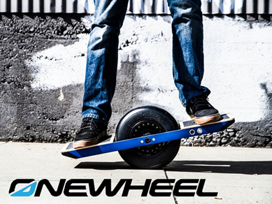
Success Story - OneWheel
OVERVIEW: Combined the practical necessity of moving around an urban environment with the thrill of board sports. Created a product that is equally at home on pavement, grass, dirt, or sand.
PRODUCT: A self-balancing, electric skateboard equipped with a single 11.5-inch tire and a battery-powered 2HP motor.
SIMULATION: Used to optimize weight and structural integrity of the chassis, plus some composites modeling for the chassis. Long-term goal is to model the motor as well.
“We estimate that it costs about $10,000 to design, build and test a physical prototype. Now that we have access to ANSYS software, we can better predict performance in the real world - which means we are building far fewer prototype boards. In addition, we can work a lot faster.”
-Kyle Doerksen
Founder & CEO

Slide 14
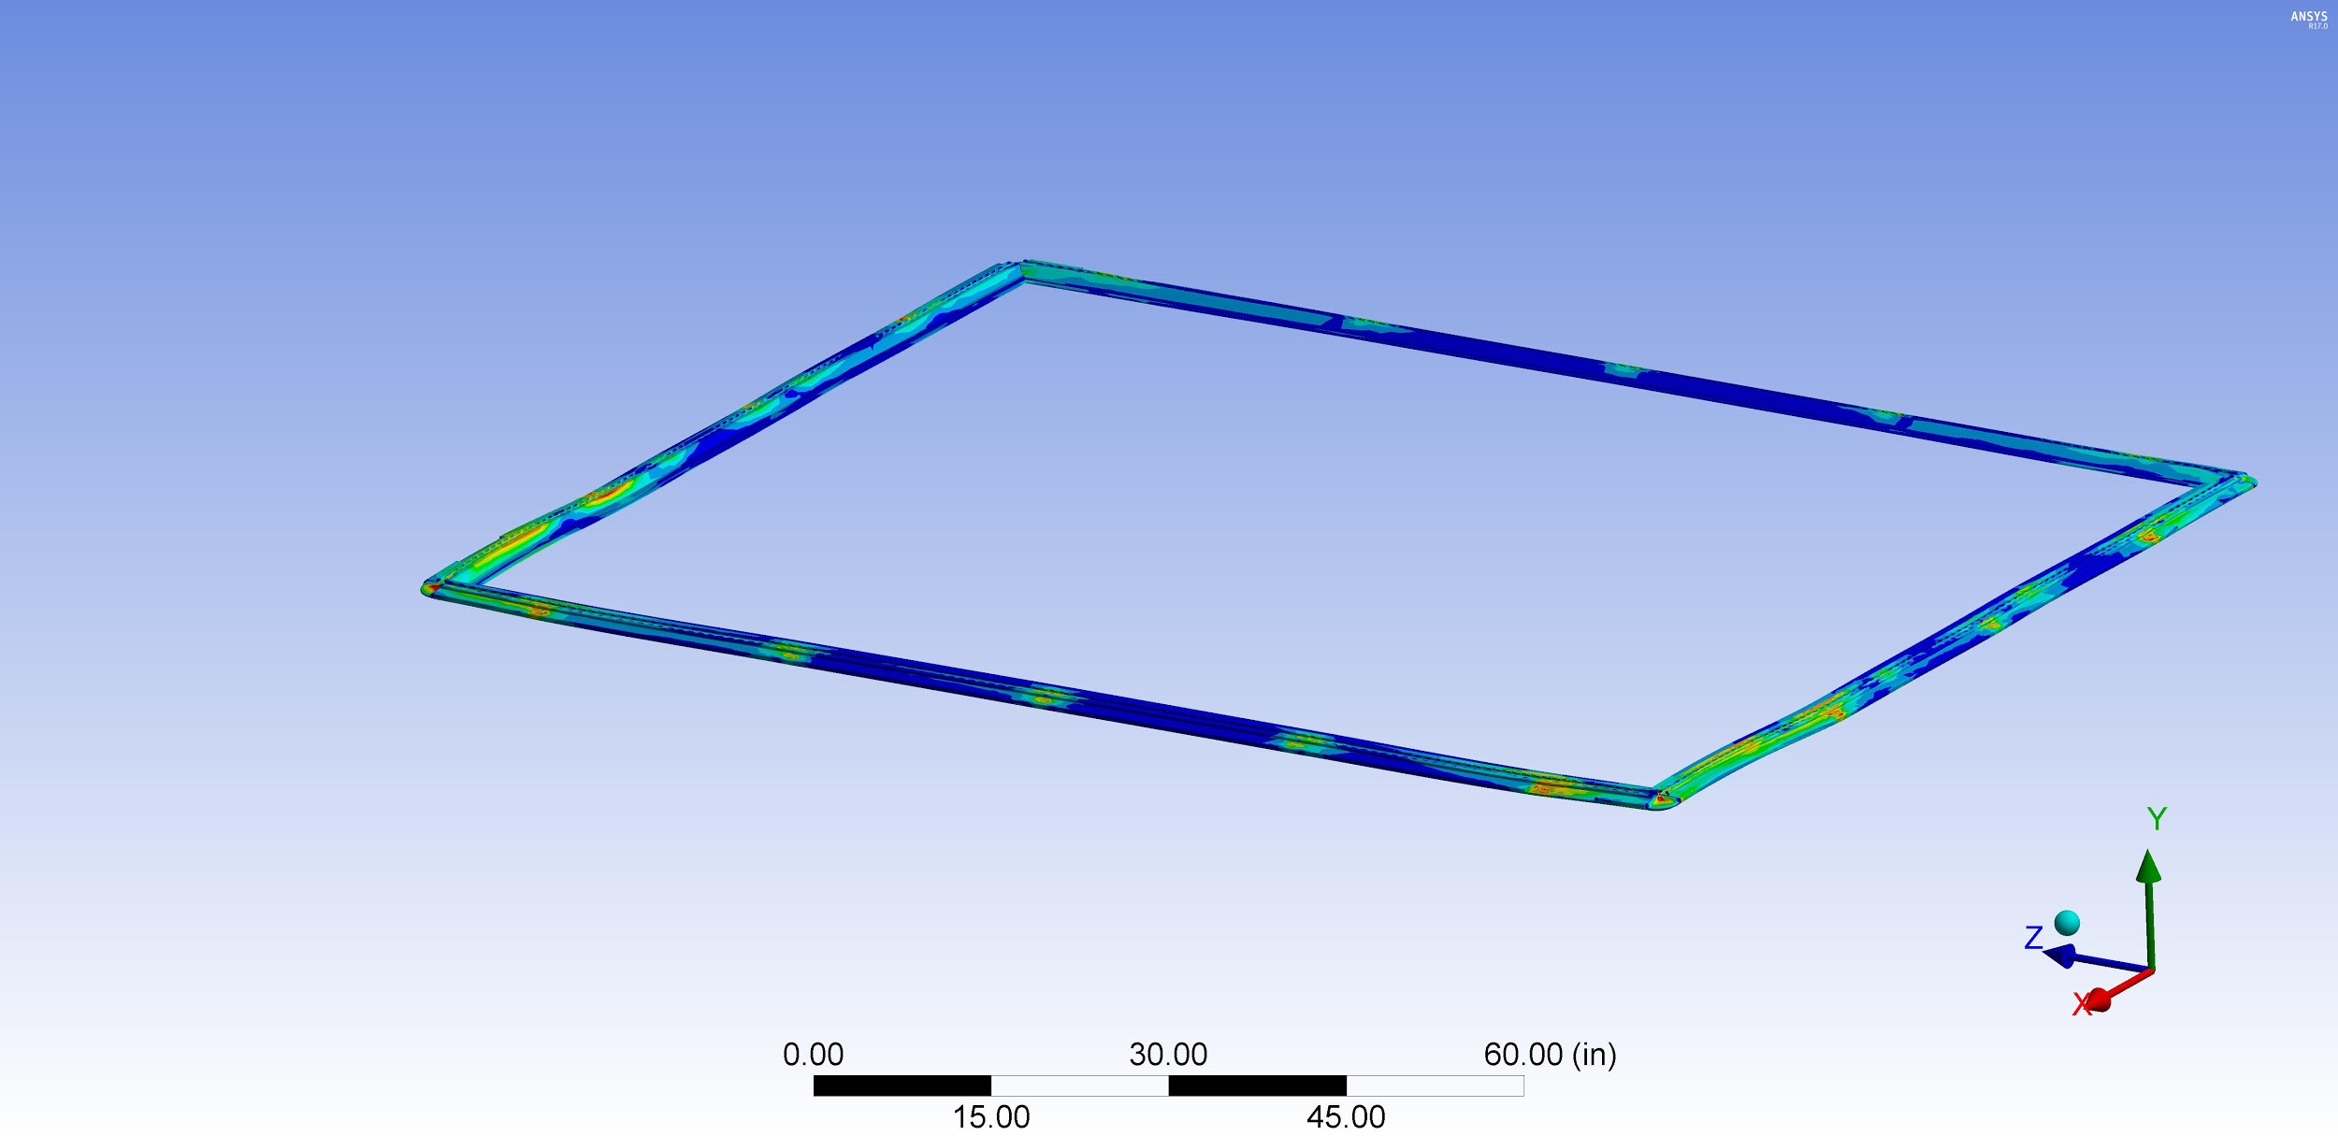
Success Story - Carbon Freight
OVERVIEW: Lightweighting is one of the most important trends in aerospace industry, but little attention has been paid to reducing the weight of cargo carried by planes everyday.
PRODUCT: Created flexible, lightweight cargo containers that are 18% lighter than traditional pallets.
SIMULATION: Used to understand and manage how pallets will react to diverse physical stress. Also, used to manage one of their biggest challenges, securing regulatory approvals from FAA and other organizations.
“We’ve been able to test different material thicknesses and fiber orientations without the time and expense of creating physical prototypes...we’re really happy with the accuracy of our simulations.”
-Glenn Philen
CEO

